Slide 1




Noida Institute of Engineering and Technology, Greater Noida
Memory Management
Unit: 4
Operating Systems
Mr. Minhaj Nezami
Assistant Professor
Department of IT
Course Details (B Tech 3rd Sem)

Slide 2


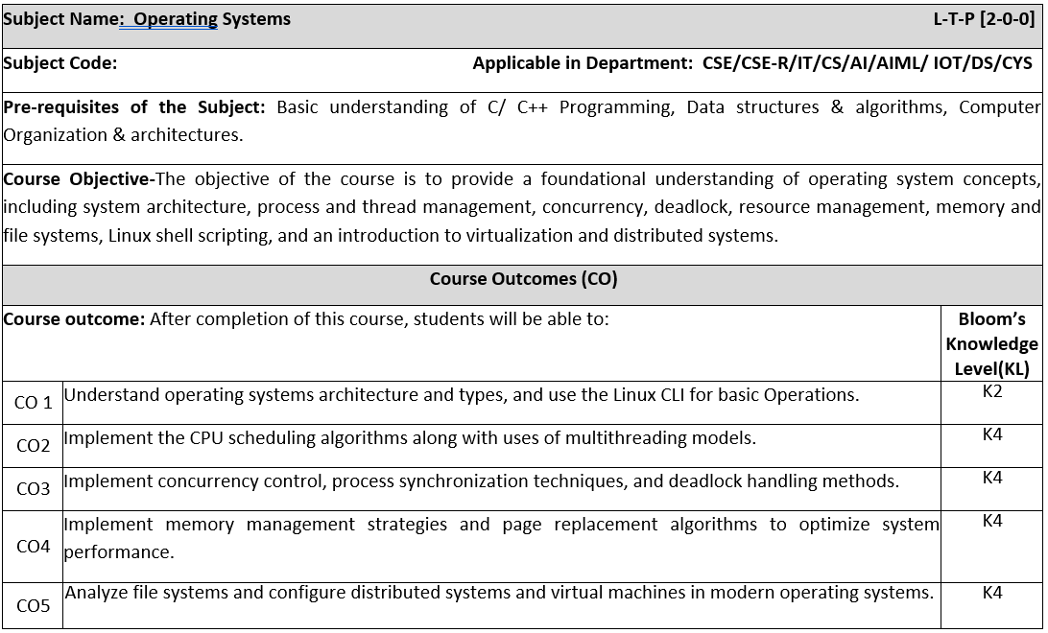
Noida Institute of Engineering and Technology, Greater Noida
Subject Name: Operating Systems L-T-P [2-0-0]
Subject Code: Applicable in Department: CSE/CSE-R/IT/CS/AI/AIML/ IOT/DS/CYS
Pre-requisites of the Subject: Basic understanding of C/ C++ Programming, Data structures & algorithms, Computer Organization & architectures.
Course Objective-The objective of the course is to provide a foundational understanding of operating system concepts, including system architecture, process and thread management, concurrency, deadlock, resource management, memory and file systems, Linux shell scripting, and an introduction to virtualization and distributed systems.
Course Outcomes (CO)
Course outcome: After completion of this course, students will be able to: |  |  |  |  |  | Bloom’s Knowledge Level (KL)
CO 1 | Understand operating systems architecture and types, and use the Linux CLI for basic Operations. |  |  |  |  | K2
CO2 | Implement the CPU scheduling algorithms along with uses of multithreading models. |  |  |  |  | K4
CO3 | Implement concurrency control, process synchronization techniques, and deadlock handling methods. |  |  |  |  | K4
CO4 | Implement memory management strategies and page replacement algorithms to optimize system performance. |  |  |  |  | K4
CO5 | Analyze file systems and configure distributed systems and virtual machines in modern operating systems. |  |  |  |  | K4
Syllabus
Unit No | Module Name | Topic covered | Pedagogy | Lecture Required (L+P) | Practical/ Assignment/ Lab Nos | CO Mapping
1 Fundamentals & Shell scripting | Module 1.1: Fundamentals of Operating Systems | Fundamentals of Operating Systems, Overview of Operating Systems, Generations of OS, Operating system architecture, Interrupt handling, System call and kernel, Types of Operating System: Batch OS, Multiprogramming OS, Multitasking OS, Multiprocessor OS, Real time OS. | Class room Teaching, Smart Board, PPT. | 2 | Assignment 1 | CO1
 | Module 1.2: Shell Scripting in Linux | Shell Scripting in Linux, Introduction to Linux Operating System & Architecture, Basic Command Line Interface (CLI) Operations in Linux, Shell Scripting Basics: Variables, Control Structures, Functions Case Study: Automating system administration tasks using shell scripts in Ubuntu/Linux (e.g., backup scheduling). | Class room Teaching, Smart Board, PPT. | 2 |  | CO1
2 Process & Thread Management | Module 2.1: Process Management and CPU Scheduling | Process Management: - Process, Transition Diagram, Process Control Block (PCB), Types of Schedulers: Long Term, Mid Term, Short Term Scheduler. CPU Scheduling- Pre-emptive and Non-Pre-emptive Algorithm (FCFS, SJF, SRTF, Non-Pre-emptive Priority, Pre-emptive Priority, Round Robin, Multilevel Queue Scheduling and Multilevel Feedback Queue Scheduling) . | Class room Teaching, Smart Board, PPT. | 4 | Practical 4 to 9 | CO2
 | Module Thread | Thread: - Processes vs Threads, Thread states, Benefits of threads, Types of threads, Multithread Model, Concept of Hyper-Threading Case Study: - Analyse and implement CPU Scheduling in Real-Time Embedded Systems and RTOS | Class room Teaching, Smart Board, PPT. | 4 | Assignment 1 | CO2
3 Concurrency and Deadlock Management | Module 3.1: Concurrency , Process Synchronization | Concurrency: Introduction of Concurrency, Types of Process, Race Condition, Critical Section, Inter Process Communication, Producer consumer problem. Process Synchronization: Lock variable, Peterson’s Solution, Strict alternation, Lamport Bakery Solution, Test and set lock, Semaphore- counting, binary and monitor, Classical Problem of Synchronization: - Bound Buffer, Dinning Philosopher, Reader writer, Sleeping barber. | Class room Teaching, Smart Board, PPT. | 4 | Assignment 2, Practical 10,11,12 | CO3
 | Module 3.2: Deadlock | Deadlock: Deadlock, Deadlock characterization, Deadlock Prevention, Deadlock Avoidance: Bankers Algorithms, Deadlock Detection, Recovery from Deadlock. Case Study: Deadlock avoidance in database transaction management systems like Oracle or MySQL. | Class room Teaching, Smart Board, PPT. | 4 | Practical 13,14 | CO3
4 Memory Management | Module 4.1: Memory Management | Memory Management: - Memory Management function, Loading and linking Address Binding, Memory management techniques, Contiguous technique- Fixed Partitions, variable partitions, Memory Allocation: Allocation Strategies (First Fit, Best Fit, and Worst Fit), Non-contiguous, Paging, Segmentation, Segmented paging | Class room Teaching, Smart Board, PPT. | 4 | Assignment 3 | CO4
 | Module 4.2: Virtual memory | Virtual Memory:- Virtual Memory Concepts, Demand Paging, Performance of Demand Paging, Page Replacement Algorithms: FIFO, LRU, Optimal and LFU, Belady’s Anomaly, Thrashing Case Study: Virtual memory management in modern OS like Windows 10 and how paging impacts performance. | Class room Teaching, Smart Board, PPT. | 4 | Practical 21 to 23 | CO4
5 File Management & Modern Operating System | Module 5.1: | File Management: - Access Mechanism, File Allocation Method, Free Space Management: -Bit Vector, Linked List. DISK: Disk Architecture, HDD vs SSD, Disk Scheduling Algorithms | Class room Teaching, Smart Board, PPT. | 2 | Practical 22 to 24 | CO5
 | Module 5.2: | Modern Operating System: -Overview of modern operating system, Modern OS features: Multitasking, virtualization, security, scalability, Shared Memory concepts, Distributed system, Parallel system & its architecture, Virtual machines – hypervisor, Introduction to GPU Case Study: Large File Storage in a Distributed Manner. | Class room Teaching, Smart Board, PPT. | 2 | Assignment 3 | CO5
Total |  |  |  | 32
Syllabus Of Course

Slide 3
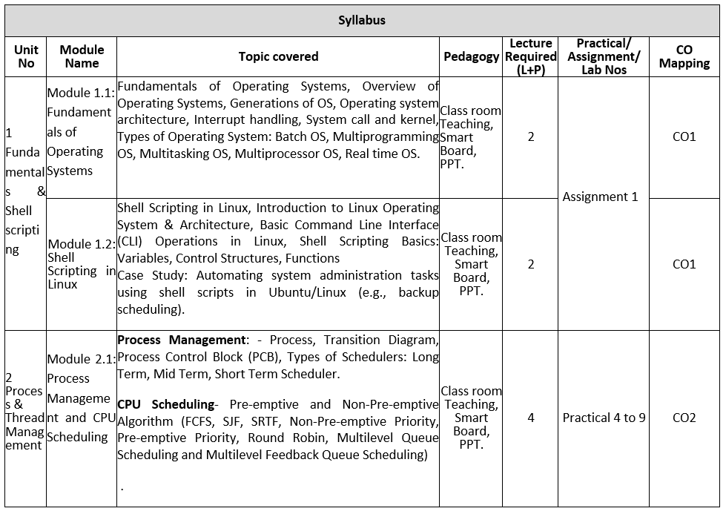
Noida Institute of Engineering and Technology, Greater Noida
Syllabus Of Course

Slide 4
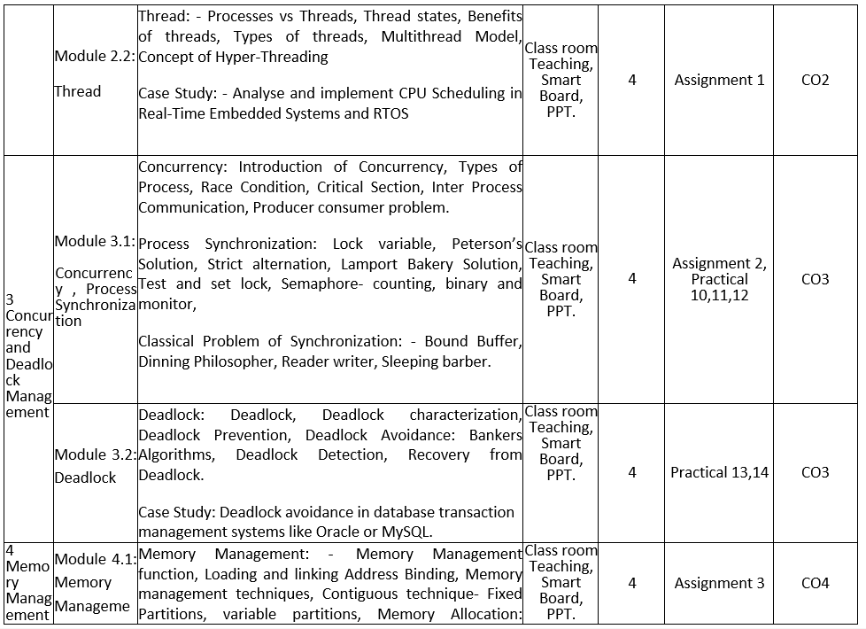
Noida Institute of Engineering and Technology, Greater Noida
Syllabus Of Course

Slide 5
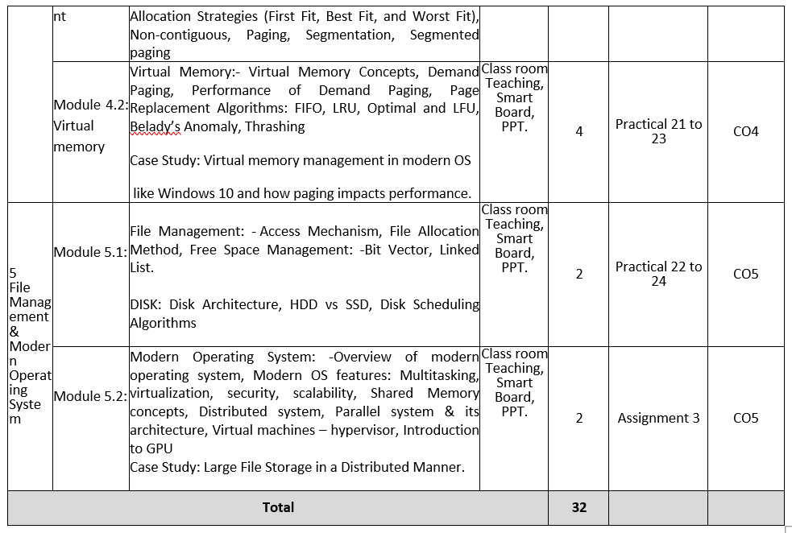
Syllabus Of Course

Slide 6
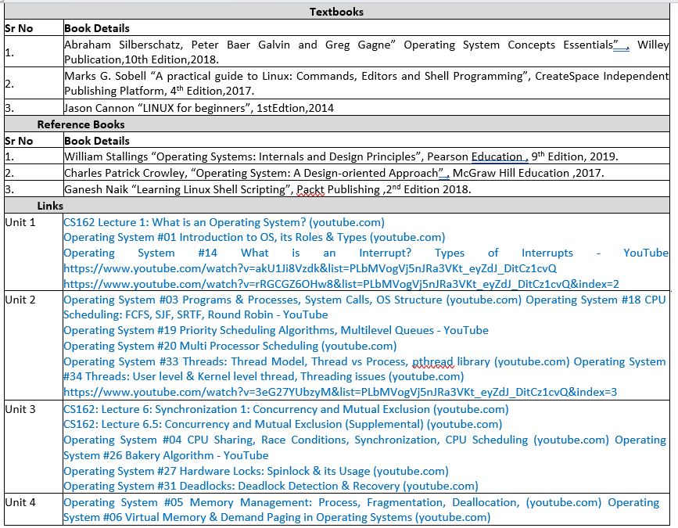
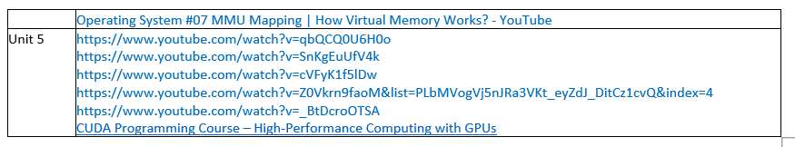

Slide 7
Noida Institute of Engineering and Technology, Greater Noida
Branch wise Application
Airlines reservation system.
Air traffic control system.
Systems that provide immediate updating.
Used in any system that provides up to date and minute
information on stock prices.
Defense application systems like RADAR.
Networked Multimedia Systems.
Command Control Systems.

Slide 8
Content
Memory Allocation
Contiguous
Fixed Partition
Variable partition
Non Contiguous
Paging
Segmentation
Segmentation with paging
Virtual Memory
Demand Paging
Global and local page replacement
Page replacement algorithms
FIFO
LRU
OPTIMAL
Thrashing

Slide 9
Memory Allocation
Definition: Memory management is a function of the OS that manages primary memory (RAM).
Objectives: Allocate memory to processes.
Deallocate memory when processes terminate.
Optimize memory usage and prevent fragmentation.
Functions: Track memory allocation.
Manage free and used memory blocks.
Handle swapping and paging.

Slide 10
Address Binding
Address Binding: Mapping logical addresses (generated by the CPU) to physical addresses (in memory).
Types of Address Binding:
Compile Time: Physical address decided at compile-time.
Load Time: Address is determined when the program is loaded into memory.
Execution Time: Address is resolved dynamically during execution.
Loading: Placing programs into memory.
Linking: Combining program modules into a single executable file.

Slide 11
Memory Management Techniques
Divided into two categories:
Contiguous Memory Allocation
Memory is allocated in a single continuous block.
Non-Contiguous Memory Allocation
Uses paging or segmentation for efficient allocation.

Slide 12
Memory Allocation
Topic Objective: To understand memory allocation schemes
One of the major functions of OS is memory management.
The OS controls the allocation/de-allocation of physical memory.
It keeps track of memory occupancy, loading of programs into free memory space, getting the memory occupied by a process when the process terminates, dynamic allocation/de-allocation of memory to executing process.

Slide 13
Memory Allocation
Topic Objective: To understand memory allocation schemes
One of the major functions of OS is memory management.
The OS controls the allocation/de-allocation of physical memory.
It keeps track of memory occupancy, loading of programs into free memory space, getting the memory occupied by a process when the process terminates, dynamic allocation/de-allocation of memory to executing process.

Slide 14
Memory Allocation
Memory Allocation
Contiguous
Fixed Partition
Dynamic Partition
Non-Contiguous
Paging
Segmentation
Segmentation with paging

Slide 15
Memory Allocation
Topic objective: To understand the contiguous memory allocation and its type.
In this allocation, a memory resident program occupies a single continuous block of physical memory.
The physical memory is partitioned into block of different sizes for accommodating the programs. This partitioning is of two types:
Fixed partitioning
Variable partitioning

Slide 16
Fixed Partitioning
Topic Objective: To understand the mechanism of fixed partitioning.
The memory is divided into a fixed number of partitions of different sizes, which may suit the range of usually occurring program sizes. Each partition can accommodate exactly one process. Thus, the degree of multi-programming is fixed.

Slide 17
Implementation of Fixed Partitioning
Topic objective: To understand the various steps in implementing the fixed partitioning scheme.
Whenever, a program needs to be loaded, a partition, big enough to accommodate the program, is allocated. Since a program may not exactly fit the allocated partition, some space may be left unoccupied, after loading the program. This space is wasted and it termed as internal fragmentation.
Memory management is implemented using a table called partition description table(PDT).

Slide 18
Advantages of Fixed Partition
Topic objective: Analyze the fixed partition scheme from implementation point of view.
The implementation is very easy.
The processing overheads are low

Slide 19
Disadvantages of Fixed Partition
Topic objective: Analyze the fixed partition from the point of memory utilization
The degree of multiprogramming is fixed, since the number of partition is fixed.
Suffers from internal fragmentation

Slide 20
Dynamic Partitioning
Topic objective: To understand the dynamic partitioning and how we remove the limitation of fixed partition by implementing it.
This scheme is free of the limitations encountered in the case of fixed partitioning.
Its functions are as follows:
Initially, the entire available memory is treated as a single partition.
The incoming programs, requesting memory allocation, are queued up.

Slide 21
Dynamic Partitioning
Topic objective: To understand and implement dynamic partitioning.
A waiting program is loaded, only when a free partition, big enough to fit the program, is available. When a program is loaded, it is allocated a space , exactly equal to its size. The balance unoccupied space, in the allocated partitioned is treated as another free space.

Slide 22
Dynamic Partitioning
When a process terminates, it releases the partition occupied. If the released partition is continuous to another free partition, then both the free partitions are clubbed together into a single free partition.

Slide 23
External fragmentation
Topic Objective: To elucidate the concept of external fragmentation and removal of it through compaction technique.
When a free partition is too small to accommodate any program, it is called External fragmentation.
External fragmentation refers to the large number of small chunks of free memory that may be scattered all over the physical memory and individually each of the chunks may not be big enough to accommodate even the small program.

Slide 24
External fragmentation
However, if joined together, the total free space, thus resulted, may be big enough to accommodate some more programs that may be waiting for loading.
Compaction is a technique, by which the resident programs are re-located in such a way that the small chunks of free are made contiguous to each other and clubbed together into a single free partition, that may be big enough to accommodate Some more programs. But the compaction has very high processing overheads.

Slide 25
Daily Quiz
Which of the following is NOT a function of memory management? a) Allocation of memory to processes b) Deallocation of memory c) Preventing CPU overheating d) Handling fragmentation
Address binding done during program execution is known as: a) Compile-time binding b) Load-time binding c) Execution-time binding d) Dynamic binding
In fixed partitioning, unused memory within allocated partitions is referred to as: a) External fragmentation b) Internal fragmentation c) Swapping d) Segmentation
What is the main issue with variable partitions? a) Internal fragmentation b) External fragmentation c) High implementation complexity d) Low memory utilization
Fill in the Blanks
In __________ memory allocation, a single contiguous block is allocated to each process.
__________ is the process of mapping logical addresses to physical addresses.
External fragmentation occurs in __________ memory allocation technique.

Slide 26
Different Strategy for Partition Allocation
Topic objective: To explore the following allocation strategies and its implementation.
There are three strategies:
First Fit
Best Fit
Worst Fit

Slide 27
First Fit
Topic Objective: To analyze its merit and demerit.
This refers to the allocation of the first encountered partition that may be big enough to accommodate the program being loaded. This algorithm works both for fixed as well as variable partition allocation.
Advantage: search time is small
Disadvantage: The memory loss, on account of fragmentation, is likely to be high.

Slide 28
Best Fit
Topic objective: To analyze the merits and demerits of Best fit allocation strategy.
It refers to the allocation of the smallest available free partition that may be big enough to accommodate the program being loaded. This algorithms also works for both fixed partition and variable partition.
Advantage: The memory loss, on account of fragmentation will be lesser than in the case of first fit.
Disadvantage: Search time will be larger, as compared to first fit.

Slide 29
Worst Fit
Topic objective: To analyze the merits and demerits of worst fit allocation strategy.
It refers to the allocation of the largest partition out of the ones which are available, which may be bigger enough to accommodate the program.
The sprit behind this scheme is that the balance space, left in the allocated partition, after loading program, may be big enough to load another small program; and in that eventually, memory loss due to fragmentation may be lower than first fit. Search time in this scheme would be of the same order as in the case of Best Fit.

Slide 30
Worst Fit
Advantage: It is expected to provide a smaller memory loss on account of fragmentation.
Disadvantage: Search time is larger than first fit. It is same as in the case of Best Fit.
This algorithm is designed only for variable-partition allocation.
By mistake if used along with fixed partition, the results will be suicidal.

Slide 31

Memory protection in contiguous memory allocation
Topic objective: To implement security for protecting the data from address space.
If (Logical address L < limit register Value M)
Physical address P=Logical address L + Relocation value R;
else
Raise Exception: Invalid Address

Slide 32
Non-Contiguous Memory Allocation
Topic Objective: To understand and implement the non-contiguous memory allocation scheme.
It offers the following advantages over contiguous memory allocation:
Permits sharing of code and data amongst processes.
There is no external fragmentation of physical memory.
Supports virtual memory concepts.

Slide 33
Non-Contiguous Memory Allocation
Topic objective: To understand the implementation of non contiguous memory allocation.
It involves a complex implementation and involves additional costs in terms of memory and processing.
It can be implemented by the concept of:
Paging
Segmentation
Segmentation with paging

Slide 34
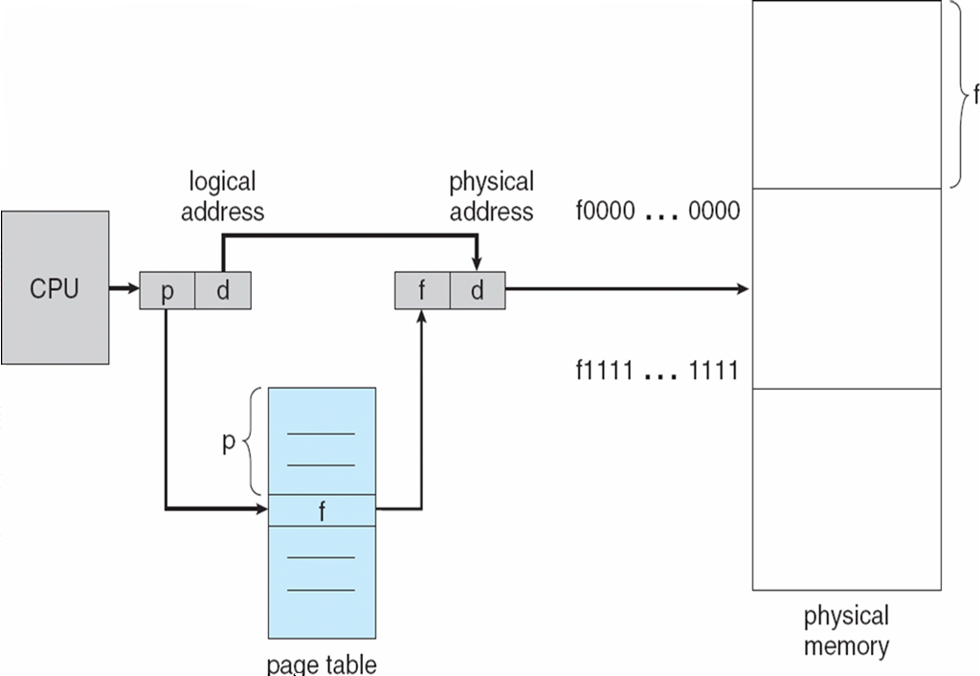
Paging
Topic Objective: To explain the paging hardware with the help of following diagram

Slide 35
Paging
Topic Objective: To understand the paging mechanism and how logical address is translated into physical address in this mechanism
It permits physical address space of a process to be non-contiguous.
The logical address space of a process is divided into blocks of fixed size called Pages.
Also, the physical memory is divided into blocks of fixed sizes called Frames.
In the system, the page and frame will be of same size.

Slide 36
Paging
The size is of the order of 512 bytes to a few MB.
Whenever, a process is to be executed, its page are moved from secondary storage(Hard disk) to the available frames in physical memory(RAM).
The information about frame number, in which a page is resident, is entered in page table. The page table is indexed by page number.

Slide 37
Translation of Logical address into physical address
For a ‘m’ bit processor, the logical address will be m bits long.
Let the page size be 2^{n} bytes.
Then lower order n bits of a logical address (L) will represent page offset(d) and the higher order m-n bits will represent the page number (p).
Then page number p=L/2^{n}
And page offset d=L%2^{n}

Slide 38
Translation of Logical address into physical address
Let f be the frame number that holds the page referenced by logical address (L).
Then f can be obtained by indexing into page table, by using page number p as index
f=page-table[p].
Corresponding physical address (P)=f*2^{n} + d
This physical address is fed to MMU to access the memory location, referenced by logical address L.

Slide 39
Internal Fragmentation in Paging
Topic Objective: To compute internal fragmentation in paging mechanism.
Since, a program size may not be an exact multiple of the page-size, some space would remain unoccupied in the last page of the process.
The average memory loss, due to internal fragmentation, would be of the order of half page per process. So, larger the page size, larger would be the loss of memory, by internal fragmentation.
Suppose, a system supports a page-size of P bytes.
Then a program of size M bytes, will have an internal fragmentation= P-(M%P) bytes

Slide 40
Limitation of Basic Paging Scheme
Topic objective: to compare paging with fixed partitioning scheme.
The effective memory access time increases, since for accessing of an operand, first its frame number has to be accessed. Since, the page table resides in the RAM itself, the effective access time to get an operand will be twice the RAM access time. So, if RAM access time is 100 ns, the effective access time would be 200 ns.
The page table occupies a significant amount of memory

Slide 41
How to Reduce the Effective Access Time in Paging?
Topic Objective: To increase the performance of paging mechanism by introducing the concept of TLB.
TLB (Translation Look-aside Buffer) is page-table cache, which is implemented as a fast associative memory. The associative memory is distinguished by its ability to search for a key, concurrently in all entries in a table.
This property makes the associative memory much faster than conventional RAM. But it is much costlier also.

Slide 42
How to Reduce the Effective Access Time in Paging?
Topic Objective: to compare TLB with RAM.
Due to higher cost, it may not be cost effective to have entire page table in TLB, but a subset of page table, that may be currently active, can be moved to TLB.
Each entry of TLB would contain Page no. of a page and the Frame no. where the page is stored in RAM

Slide 43

TLB
Topic objective: To explain mechanism of TLB Hardware with the help of following diagram.

Slide 44
TLB
Topic Objective: To understand the mechanism of TLB.
Whenever, a logical address is generated, the page no. p of the logical address is fed as a key to the TLB.
The key is searched in parallel in all the entries of TLB.
If the match found for the page no. p, it is termed as TLB hit. The entry, with the matching number contains the frame no., where the page is stored.

Slide 45
TLB
If match not found for the page no., it indicates TLB miss. Then, the frame no. is accessed from the page table. Also, the page table entry is moved to TLB, so that for further references to that page, its frame no. can be accessed from TLB itself.
If TLB is full, then some replacement algorithm can be used to replace one of the existing entries in the TLB.

Slide 46
Improvement in effective memory access time
Topic objective: To compute the effective memory access time of cache memory.
TLB Hit ratio=0.9
RAM access time T=100 ns and TLB access time t=20 ns
Effective access time without TLB= 2T=200 ns
Effective access time with TLB
=H*(T + t) + (1-H) * (2*T + t)
=0.9*(100+20) + (1-0.9)*(2*100+20)
=0.9*120+0.1*220=108+22=130 ns
Reduction in effective access time=(200-130)*100/200=35%

Slide 47

Inverted Page Table(IPT)
Topic Objective: To explain the mechanism of IPT with the help of following diagram.

Slide 48
Inverted Page Table(IPT)
Topic Objective: To explain the translation of logical address into physical address using IPT
The size of IPT is related to the size of the physical memory, not the size of logical address space. Since IPT is not process specific and it does not need switching during context switching of the processes. IPT contains process id along with page no. for each frame in the physical memory. IPT is system wide not per process.

Slide 49
Inverted Page Table(IPT)
A logical address generated by CPU contains process-id(pid), Page no.(p) and page offset(d). A search is carried out in IPT to find a match for the process id and the page number. The offset of the matching slot in the IPT, gives the frame number, where the desired page is residing. The frame number combined with the offset d, gives the intended physical address.

Slide 50
Advantages of IPT over conventional Page Table
Topic Objective: Comparison of IPT with conventional Page Table.
There is only one page table for all processes, whereas conventional page table is per process.
Its size is related to the size of physical memory available.
Limitations: The search time to match an entry in IPT is very large.
The average search time of IPT can be reduced by combining the IPT with a TLB.

Slide 51
IPT with a TLB
Topic Objective: Comparison of IPT with TLB.
Each entry in the TLB would comprise Page number, process-id and its corresponding frame number. The associative memory would permit matching of a process-id and page number pair simultaneously with all the entries in TLB. The desired frame number can then be obtained from the matching entry.

Slide 52
IPT with a TLB
Each entry in the TLB would comprise Page number, process-id and its corresponding frame number. The associative memory would permit matching of a process-id and page number pair simultaneously with all the entries in TLB. The desired frame number can then be obtained from the matching entry.

Slide 53

Hashed Page Table
Topic Objective: To explain the mechanism of Hashed Page Table with the help of following diagram

Slide 54
Hashed Page Table
Topic objective: Translation of logical address into physical address using Hashed Page Table.
A page table is created of length M.
Whenever, logical address is generated, a hashing function is applied to the page number p, to generate an index i.
i=p%M;
The index value i is used to index into the page table. Each entry in the page table is a pointer to a linked list.

Slide 55

Multi-level Paging
Topic Objective: To explain the mechanism of multi-level paging with the help of following diagram

Slide 56
Multi-level Paging
Topic Objective: To explain the steps for translating logical address into physical address in multi-level paging scheme.
The page table is split into multiple levels. For example, in a two level page table, a logical address would comprise of the following fields:
(a)Page number p1, for indexing into outer page table.
(b)Page number p2, for indexing into inner page table.
(c)Offset or displacement d that is used to index into the selected frame, to obtain the desired operand

Slide 57
Multi-level Paging
The page table is split into multiple levels. For example, in a two level page table, a logical address would comprise of the following fields:
(a)Page number p1, for indexing into outer page table.
(b)Page number p2, for indexing into inner page table.
(c)Offset or displacement d that is used to index into the selected frame, to obtain the desired operand

Slide 58
Advantage of Multi-level Paging
Topic objective: To explain the advantages of multi-level paging.
All the inner page tables would not be required to be memory resident simultaneously. Depending upon the size of executing program only a small fraction of the set of inner page tables would need to be memory resident, thus reducing the memory overhead of the page table.

Slide 59
Disadvantage of Multi-level Paging
Topic objective: To explain the disadvantage of multi-level paging.
To access an operand, multi-level paging needs some extra memory accesses. For example, in the case of two level paging, an additional memory access is required, that is, to get the base address of inner page table.

Slide 60
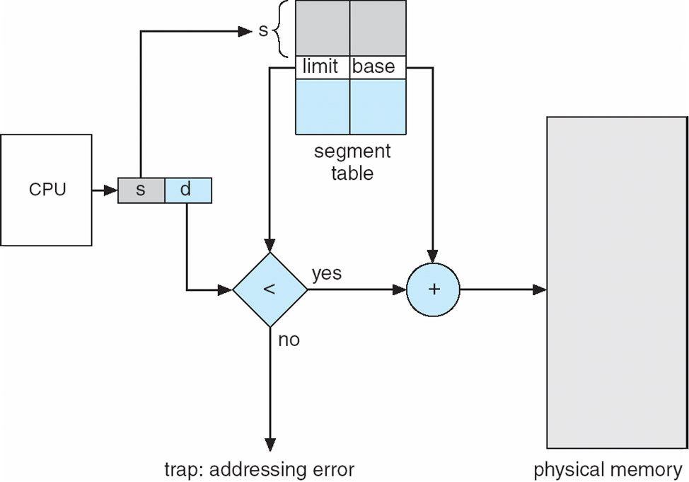
Segmentation
Topic objective: To understand segmentation mechanism with the help of following diagram

Slide 61
Segmentation
Topic objective: How logical address is translated into physical address in segmentation mechanism.
In segmentation, the physical memory is divided into segments of varying sizes. Each segment is assigned a unique segment number.
The memory management is done through a segment table, which is indexed by segment number. For each segment, it has an entry that provides base address of the segment and size of the segment. The logical address contains segment number ‘s’ and offset within the segment ‘d’

Slide 62
Segmentation
Using the segment number, the system obtains base address of the segment. Then it makes a check to determine whether offset is within the segment size or not. If yes then the offset d is valid and physical address is computed by adding the offset to the base address; else it is invalid (error).

Slide 63
Segmentation with paging
Topic Objective: To understand and implement the segmentation with paging mechanism.
In this, the logical space is divided into a number of segments of varying sizes and each segment is divided into a number of pages, each of a fixed size.
The memory management is done through a segment table. Each segment has an entry in the table. An entry contains base address of the segment page table and size of the segment page table.

Slide 64
Segmentation with paging
The logical address contains segment number, page number in a segment and offset ‘d’ in the page. The segment number s is to access the segment entry in the access the segment page table. So, each segment will have a separate page table. The page number p is used to access the frame number in the page table, provide p<M (size of the segment page table); else it is invalid page number. The frame number ‘f’ is combined with the offset ‘d’ to compute the physical address.

Slide 65
Daily Quiz
Which allocation strategy places a process in the first memory block that is large enough? a) Best Fit b) First Fit c) Worst Fit d) Next Fit
Which memory allocation strategy results in the smallest leftover memory block? a) First Fit. b) Best Fit. c) Worst Fit d) Random Fit
Paging divides the process into: a) Equal-sized pages b) Variable-sized segments c) Fixed-sized blocks and pages d) None of the above
Segmented Paging is a combination of: a) Paging and Fixed Partitioning b) Paging and Variable Partitioning c) Segmentation and Paging d) Contiguous and Non-Contiguous Memory Allocation

Slide 66
Virtual Memory(VM) Concept
Topic Objective: To understand and implement the virtual memory concepts.
Virtual memory is a technique that permits execution of processes with their code only partially loaded into the physical memory.
This technique takes advantage of the fact that a program tends to have locality of reference, and a process code never required in its entirety, at the same time.

Slide 67
Virtual Memory(VM) Concept
Virtual memory is a technique that permits execution of processes with their code only partially loaded into the physical memory.
This technique takes advantage of the fact that a program tends to have locality of reference, and a process code never required in its entirety, at the same time.

Slide 68
Advantages of Virtual Memory
Topic objective: To describe the advantages of using virtual memory concepts.
Programs are not constrained by physical memory size.
Degree of multi programming can be varied over a large range

Slide 69
Implementation of VM
Topic objective: Implantation of VM concepts using demand paging and demand segmentation.
It is implemented by demand paging or by demand segmentation.
When a process is swapped-in, the pager loads a set of its pages, which may be predicted to be initially needed by the process into the physical memory.
The secondary memory holds the remaining pages of the process.

Slide 70
Implementation of VM
When a process is swapped-in, this bit is set to invalid for all the entries in the page table. When page is loaded into RAM, its frame number is entered and page validity bit is set to valid.
Thus if bit is valid, it indicates that the page is legally from the logical address space of the process and is currently in the RAM.
If it is set to invalid, it indicates that either the page does not belong to the logical address space of the process or it is still not loaded into RAM.

Slide 71
Implementation of VM
Whenever, a logical or virtual address is generated, the system operates as follows:
Looks into the page table. If the page validity bit is set to v, it reads the corresponding frame number, adds page offset and determines physical address.
If the page table indicates page invalid, then system reads the page into a free frame. If no free frame is available, it uses a page replacement algorithm to replace an occupied frame.

Slide 72
Implementation of VM
In addition to this, system needs the following system tables:
Page Map Table : This table is per process. It indicates whether the page is memory resident or not. It also contains validity bit.
Memory Map Table (Free Frames’ list): This table provides information about the availability of free frames, that can be allocated accommodate new pages. This table is per system.
File Map Table: This table is per process. It provides the disk addresses, where the process pages are stored on the secondary storage.

Slide 73
Demand Paging
Topic objective: To explain the types of demand paging.
Pure Demand Paging: All the pages are placed in secondary storage and on demand basis, it is loaded into main memory at execution or run time. At the outset, main memory is empty.
Pre-fetched Demand Paging: In this some of the selective pages are preloaded(before execution starts). Initially some of the pages are in main memory.

Slide 74
Modified/Dirty Bit
Topic objective: To understand the concept of modified and dirty bit in the implementation of Virtual Memory Concepts.
It is used to reduce one disk access.
If write operation is performed on the page after loading, then page is modified or dirty.
If page is dirty, first write the dirty page into disk and bring the requested page into main memory.
If the page is clean, no write operation is performed on the page simply replace the page with requested page

Slide 75
Global and Local Page Replacement
Topic Objective: To understand and Page Replacement Concepts and its types.
Whenever, a process experiences a page fault, if no free frame are available, then the OS gets a currently occupied frame released and allocates the released frame to the page faulting process, for accommodating the new page. If the victim page belongs to the page faulting process itself, it is called local page replacement; else it is called global page replacement. Global page replacement does not focus on the performance of individual processes. It rather focuses on the system performance.

Slide 76
FIFO Page Replacement Algorithm
Topic Objective: To implement the FIFO Page Replacement Algorithm.
It replaces the page that has been in the memory for the longest time. One possible implementation is a FIFO (queue) of the existing pages in the memory. Whenever, page fault occurs, the page at the top of the queue is made victim and the new page is put at the tail of the queue.
Reference String: It refers to the sequence of page numbers referenced by a program during its execution.
Page number = Quotient (Logical Address/Page Size), if logical address =0745 and page size =100 bytes, then page no=0745/100=7

Slide 77
Advantages and Disadvantages of FIFO
Topic Objective: To explain the merit and demerit of FIFO Page Replacement Algorithm.
Advantage: Implementation is fairly simple
Limitation: This algorithm does not take into account the current usages of pages and may often eject some pages that may be currently active. Such pages would need to be moved in frames again, in near future.
Also, if the system has global page replacement, then the program having largest number of allocated pages would have higher page fault rate, since the probability of oldest page, belonging to this program would be very high. This phenomena is called Belady’s Anomaly and it defies intuition.

Slide 78

















No. of Faults using FIFO
7
7
7
2
2
2
2
4
4
4
0
0
0
0
0
0
0
7
7
7
No. of Frames
0
0
0
0
3
3
3
2
2
2
2
2
1
1
1
1
1
0
0
1
1
1
1
0
0
0
3
3
3
3
3
2
2
2
2
2
1
Status
F
F
F
F
H
F
F
F
F
F
F
H
H
F
F
H
H
F
F
F

Slide 79
No. of Faults using FIFO
Total no. of page fault or misses =15
Total no. of Hits = 5
Hit ratio= 5/20=0.25
Page fault % = (15/20)*100=75%

Slide 80
LRU Page Replacement Algorithm
Topic Objective: To implement the LRU Page Replacement Algorithm.
It replaces the page which has been used least recently. So, while choosing a resident page for replacement, the algorithm considers its current usage. It is presumed that a page that has been used least recently, would be the one that would be least likely to be accessed soon. One implementation of this algorithm could be by using a stack. Whenever, a new page is brought in, it is placed at the top of stack. Also, whenever, a resident page is accessed, it is removed from its current position and moved to the top of the stack. Whenever, a page is to be replaced, victim page is chosen from the bottom of the stack.

Slide 81
LRU Page Replacement Algorithm
Topic Objective: To explain the advantages and disadvantages of LRU Page Replacement Algorithm.
Advantage: While selecting a resident page for replacement, it takes into consideration the current usage of a page. This algorithm is free from Belady’s Anomaly.
Limitations: The algorithm has a lot of processing overheads, which are needed to keep track of least recently used

Slide 82
No. of Faults using LRU
7
7
7
2
2
2
2
4
4
4
0
0
0
1
1
1
1
1
1
1
0
0
0
0
0
0
0
0
3
3
3
3
3
3
0
0
0
0
0
1
1
1
3
3
3
2
2
2
2
2
2
2
2
2
7
7
7
Status
F
F
F
F
H
F
H
F
F
F
F
H
H
F
H
F
H
F
H
H

Slide 83
No. of Faults using LRU
Total no. of page fault or misses =12
Total no. of Hits = 8
Hit ratio= 8/20=0.40
Page fault % = (12/20)*100=60%

Slide 84
Optimal Page Replacement Algorithm
Topic Objective: To implement the Optimal Page Replacement Algorithm.
In its ideal form, this algorithm should replace a page, which is to be referenced in the most distant future. Since, it requires knowledge of future, its ideal form is not implementable. The significance of this algorithm is only theoretical. It is used to compare performance of an implementable algorithm with that of the optimal.

Slide 85
Optimal Page Replacement Algorithm
Topic Objective: To compare Optimal Page Replacement Algorithm with FIFO and LRU.
Optimal algorithm appears to be best in term of number of page faults, but it is not feasible to implement this algorithm since the algorithm requires the knowledge of future. Out of FIFO and LRU, the LRU is better, since it takes into consideration the current usage of a page whenever a resident page is considered for replacement. The page, which has been least recently used is chosen for replacement.

Slide 86
No. of Faults using Optimal Page Replacement
No. of Frames 3
7
7
7
2
2
2
2
2
2
2
2
2
2
2
2
2
2
7
7
7
0
0
0
0
0
0
4
4
4
0
0
0
0
0
0
0
0
0
0
1
1
1
3
3
3
3
3
3
3
3
1
1
1
1
1
1
1
Status
F
F
F
F
H
F
H
F
H
H
F
H
H
F
H
H
H
F
H
H

Slide 87
No. of Faults using Optimal Page Replacement
Total no. of page fault or misses =09
Total no. of Hits = 11
Hit ratio= 11/20=0.55
Page fault % = (9/20)*100=45%

Slide 88
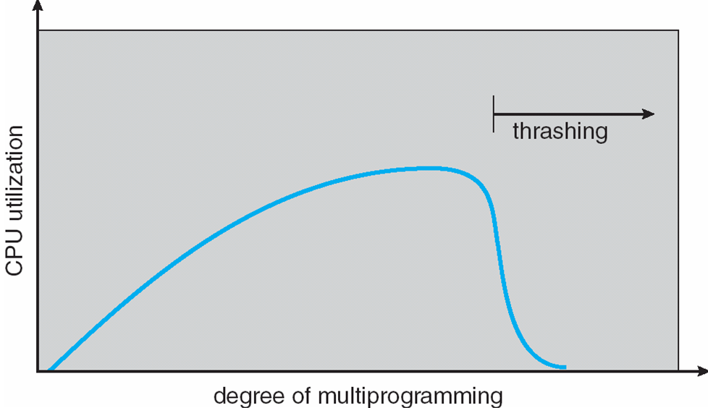
Thrashing
Topic objective: To understand the concept of thrashing and how it impacts adversely on the performance of the system
As we increase the degree of multiprogramming CPU utilization increases to a certain limit, after that drastically decreases that is called thrashing.

Slide 89
Working Set Model
Topic objective: Removal of thrashing with the help of working set model.
It is one of the solution of thrashing.
It is based on assumption of locality of reference.
It uses ∆, working set window
Idea is to examine recent working set window page references
If a page is in active use, it will be in working set window and if it is no longer being used it will be dropped from working set

Slide 90
Locality of Reference of a Process(Spatial and Temporal)
Topic objective: To understand the locality of reference of a process and its type.
At any time, during its execution, a process will be accessing only a small subset of logical address space. This subset of the logical address space is called its current locality of references. The current locality keeps shifting. It also keeps varying in size. Whenever, a page forming part of the current locality is not found in the memory, it will cause a page fault. So when a process moves from one locality to another, it will get the new pages into memory through page faulting.

Slide 91
Page Fault Frequency
Topic Objective: To remove the thrashing with the concept of Page Fault Frequency.
At any time, during its execution, a process will be accessing only a small subset of logical address space. This subset of the logical address space is called its current locality of references. The current locality keeps shifting. It also keeps varying in size. Whenever, a page forming part of the current locality is not found in the memory, it will cause a page fault. So when a process moves from one locality to another, it will get the new pages into memory through page faulting.

Slide 92
Page Fault Frequency
The PFF Algorithm may be implemented as follows:
Whenever, a process is having a page fault, the OS computes the time elapsed since its last page fault. If the interval is lower than the critical value T (it indicates a PFF higher than critical), then a new frame is allocated to the process.
However, if the interval is higher than T, then frame assigned to the process, whose reference bit and written –into bit are found to be clear, is replaced by new page.
The OS sweeps and frees those frames that have not been referenced since last sweep. These frames are added to the pool of free pages. The referenced bits of the remaining resident pages are reset.

Slide 93
Case Study
Virtual Memory Management in Modern OS: Windows 10
How Paging Impacts Performance
Virtual memory provides an abstraction of memory resources
Enables multitasking, memory protection, and stability
Used in all modern operating systems including Windows 10

Slide 94
Case Study
What is Virtual Memory?
Illusion of a large continuous block of memory
Enables execution of programs larger than physical RAM
Uses hard disk (page file) when RAM is full
Supports memory protection and isolation

Slide 95
Case Study
Virtual Memory in Windows 10
Page-based memory model
Process virtual address space:
- 4 GB (32-bit) or 128 TB (64-bit)
Page size: 4 KB
Backed by pagefile.sys
Uses demand paging

Slide 96
Case Study
Tools for Monitoring
Task Manager
Resource Monitor
Performance Monitor (PerfMon)
Sysinternals: VMMap, Process Explorer

Slide 97
Case Study
What is Paging?
Divides memory into fixed-size pages (4 KB)
Maps virtual pages to physical memory frames
Loads pages into RAM as needed
Handles page hits and page faults

Slide 98
Case Study
Paging Operations
Page Hit: Page is in RAM, fast access
Page Fault: Page not in RAM, load from disk
Page Replacement Algorithms: LRU, FIFO, etc.

Slide 99
Case Study
Impact of Paging
Benefits:
• Multitasking
• Security and memory isolation
• Flexibility in memory usage
Drawbacks:
• Page faults slow down performance
• Thrashing reduces system responsiveness
• Disk I/O bottlenecks on HDDs

Slide 100
Case Study
Real-World Scenario
User runs Chrome, Photoshop, Visual Studio, and a game
RAM: 8 GB; Page file: 8 GB
High page fault rate
Application lag and freezes
Upgrade to 16 GB RAM or SSD improves performance

Slide 101
Case Study
Optimization Tips
Increase physical RAM
Use SSD for faster paging
Manually configure page file size
Monitor memory usage
Close unused background apps

Slide 102
Case Study
Conclusion
Virtual memory enables stability and flexibility
Excessive paging degrades performance
Optimization helps maintain system responsiveness

Slide 103
Faculty Video Links, YouTube & NPTEL Video Links and Online Courses Details
YouTube/other Video Links
https://www.youtube.com/watch?v=LLhgnIYpQaI
https://www.youtube.com/playlist?list=PLmXKhU9FNesSFvj6gASuWmQd23Ul5omtD
https://www.youtube.com/watch?v=xAvC-MJ_Sz8
https://nptel.ac.in/courses/106108101

Slide 104
Daily Quiz
Which of the following is responsible for memory allocation and deallocation in an operating system?
A) Compiler
B) Loader
C) Memory Manager
D) Scheduler
Dynamic memory allocation occurs at:
A) Compile time
B) Run time
C) Link time
D) None of the above
Which type of address binding occurs during program execution?
A) Compile-time
B) Load-time
C) Execution-time
D) Static-time

Slide 105
Daily Quiz
In fixed partitioning, memory is divided into:
A) Variable-sized partitions
B) Fixed-sized partitions
C) Dynamic partitions
D) None of the above
Which of the following is a disadvantage of contiguous memory allocation?
A) External fragmentation
B) Internal fragmentation
C) Both A and B
D) None of the above
Which allocation strategy finds the first free block that is large enough?
A) Best Fit
B) First Fit
C) Worst Fit
D) Next Fit

Slide 106
Daily Quiz
Which allocation strategy minimizes wasted space?
A) Best Fit
B) First Fit
C) Worst Fit
D) Random Fit
In paging, a logical address is divided into:
A) Frame number and offset
B) Page number and offset
C) Segment number and page number
D) Segment number and offset
Virtual memory allows a program to:
A) Use less memory than physically available
B) Run even if it exceeds physical memory
C) Avoid all fragmentation
D) None of the above

Slide 107
Daily Quiz
Which page replacement algorithm replaces the page that has been in memory the longest?
A) Optimal
B) FIFO
C) LRU
D) LFU
Thrashing occurs when:
A) The CPU is underutilized
B) Too many pages are replaced too frequently
C) All pages are in memory
D) The program has no working set

Slide 108
MCQ
Which of the following techniques does the memory manager use to improve memory utilization?
A) Compaction
B) Segmentation
C) Paging
D) All of the above
The role of the loader in memory management is to:
A) Execute instructions
B) Translate logical addresses to physical addresses
C) Load the program into memory
D) Allocate memory to the process
Which of the following address binding techniques allows processes to be moved between memory locations during execution?
A) Compile-time
B) Load-time
C) Execution-time
D) Static binding

Slide 109
MCQ
What is a logical address?
A) The physical address of a process in memory
B) The address generated by the CPU
C) The address used by the memory unit to fetch data
D) None of the above
In fixed partitioning, unused memory within a partition is called:
A) External fragmentation
B) Internal fragmentation
C) Page fault
D) Thrashing
In paging, the size of a page is determined by:
A) Operating system
B) Processor architecture
C) Both A and B
D) Compiler

Slide 110
Weekly Assignment
Name the common strategies to select a free hole from a set of available holes.
Explain Compaction.
Define Virtual Memory.
Name the various page replacement algorithms used for page replacement.

Slide 111
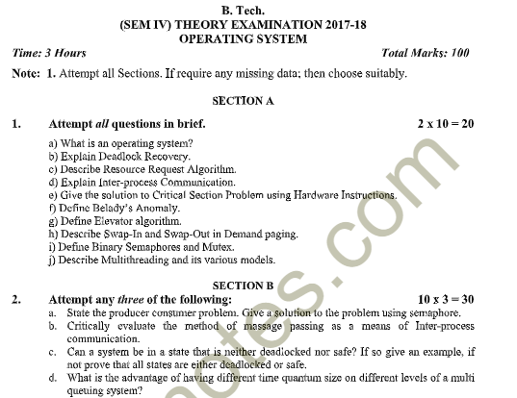
Old Question Papers

Slide 112
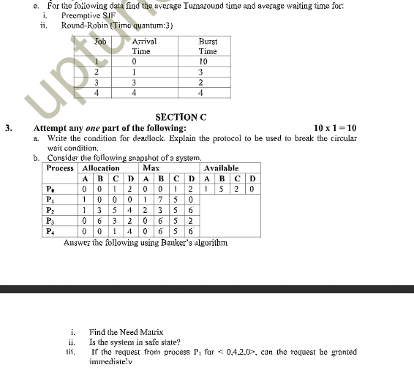
Old Question Papers

Slide 113
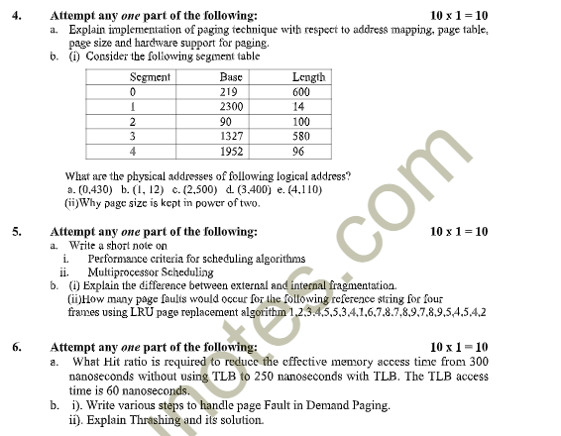
Old Question Papers

Slide 114
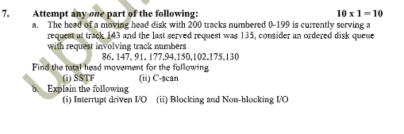
Old Question Papers

Slide 115
Glossary Questions
What is memory management in operating systems and types of memory management techniques?
Define address binding. What are the different stages of address binding?
Difference between logical and physical address?
What are contiguous and non-contiguous memory allocation?
Define fixed partitioning in memory management.
What is variable partitioning and how is it better than fixed partitioning?
What is paging in memory management?
Define segmentation. How does it differ from paging?
What is virtual memory?
Explain demand paging. How does it work?

Slide 116
Expected Questions for University Exam
Explain paging. Describe how logical address is translated to physical address in a paged system.
Explain thrashing. State the cause of thrashing and discuss its solution
Differentiate between internal fragmentation and external fragmentation.
Define Belady’s anomaly.
Differentiate between the paging and segmentation.
When do page faults occur? Describe in detail the actions taken by the operating system when a page faults occur.
7. Consider the following reference string 1,3,2,4,0,1,5,6,0,1,2,3,0,5,6,4,2,1,3,2.7,3,2.
How many page faults will occur for:
FIFO Page Replacement
Optimal Page Replacement
LRU Page Replacement
Assuming three and four frames (initially empty)

